Slide 1
WEAVE: an online worked examples viewer
By Emilia Vulpe

Slide 2
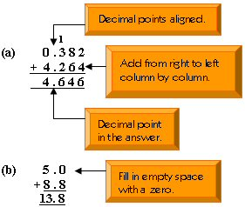
What are worked examples?

Slide 3
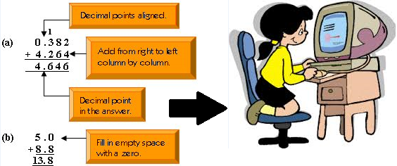
Why are worked examples beneficial for learning Computing Science?

Slide 4
Problems of the existing forms of worked examples
Do not provide enough interactivity
May not fit into the teaching needs
Provide little or no feedback

Slide 5
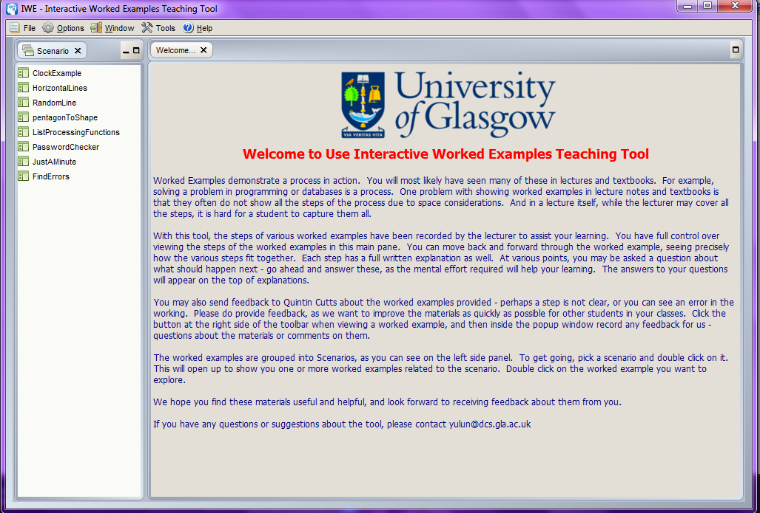
A solution to these problems

Slide 6

The context of worked examples in this Level 4 project

Slide 7

Why not use IWE in schools?
It is difficult!

Slide 8

An alternative

Slide 9
Other benefits
It will receive the latest updates of the application and the worked examples
Will enable sharing examples on national and even international level

Slide 10
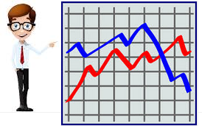
Taking a step further…

Slide 11

A necessary condition

Slide 12
Goals for this project
Build a web-based viewing system that is interoperable with the author interface of IWE
Provide an interface for teachers that will help them gain more information on how the worked examples are used by their own pupils
Replicate as closely as possible the student interface of IWE
Ensure that worked example authors can view usage data in an anonymous manner, such that individual pupils, classes or schools are not identifiable

Slide 13
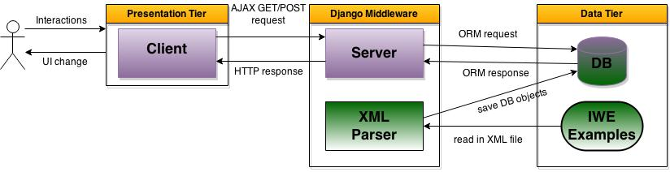
Architecture

Slide 14
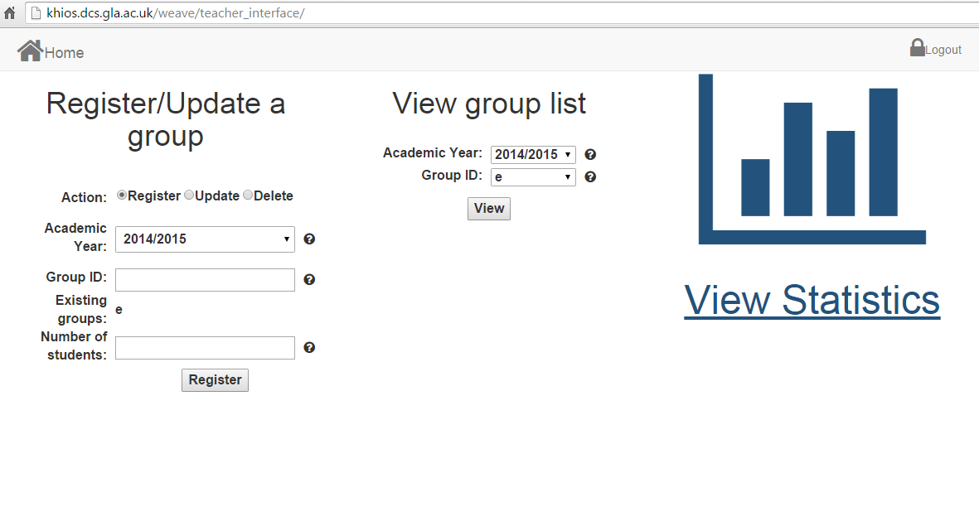
Teacher Interface

Slide 15
Student Interface

Slide 16
Evaluation
Usability Evaluation conducted by participants who are not teachers or students in Computing Science
Heuristics Evaluation conducted by experts in Django web application development
Usability Evaluation with teachers in schools
Practical Evaluation by a secondary school teacher

Slide 17
Future work
Satisfy teachers’ needs
Provide an author interface
Make revolution in teaching practices is schools?

Slide 18

Thank you!

